Slide 1
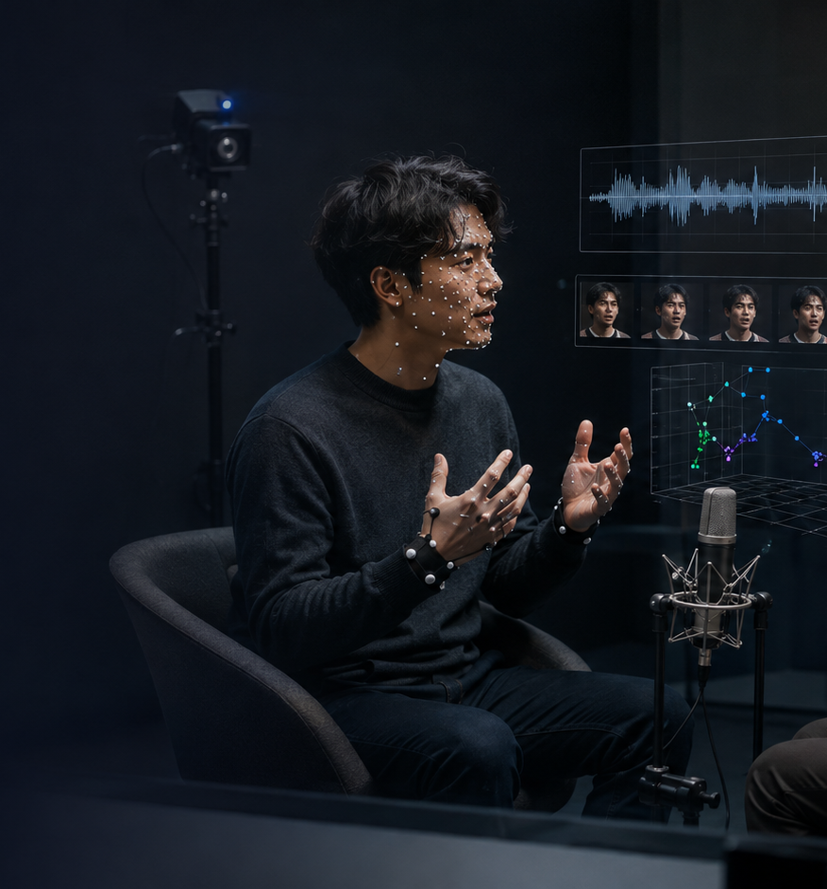
Graduate seminar | Affective computing
IEMOCAP
Interactive Emotional Dyadic Motion Capture Database
Busso et al., Language Resources and Evaluation 42(4), 2008
Planned time: 40 minutes
Core question: how do we build a corpus for emotion in interaction, rather than emotion in isolated signals?
Notes:
Timing: 1 minute. Open with the contrast to static facial-expression datasets: IEMOCAP is not only an emotion-recognition benchmark, but a database-design argument. Its contribution is a controlled attempt to capture expressive emotion in dyadic interaction, with synchronized audio, video, motion capture, transcripts, and human annotations. Source: Busso et al. 2008; USC IEMOCAP release page.

Slide 2
SEMINAR GOALS
What students should be able to do
● Explain why IEMOCAP was created and what limitations it addressed. ● Describe the corpus design: actors, dyads, elicitation, modalities, segmentation, and annotation. ● Interpret IEMOCAP’s annotation agreement as a measurement issue, not just a data-cleaning issue. ● Connect dataset design choices to modeling choices in multimodal affect recognition.
40-minute seminar stance
Treat IEMOCAP as a case study in affective dataset engineering: what counts as “emotion” depends on elicitation, context, and annotation.
IEMOCAP seminar | learning goals
2
Notes:
Timing: 1.5 minutes. Emphasize that the seminar is not primarily about a classifier, but about the pipeline that makes classification possible. The paper is useful because it exposes trade-offs—naturalness versus control, subjectivity versus label reliability, and modality richness versus scale.

Slide 3
ROADMAP
40-minute seminar arc
0–5
5–15
15–25
25–35
35–40
Problem
Design
Annotation
Evidence
Implications
Why older corpora were insufficient
How IEMOCAP was built
How emotion labels were made
What the corpus contains
How to use it critically
Recurring question: What kind of emotion does the dataset make easy to see—and what kind does it make hard to see?
IEMOCAP seminar | roadmap
3
Notes:
Timing: 1 minute. Preview the major sections and invite students to keep a dataset-audit question in mind throughout the talk. The same question will return at the end and in the CREMA-D deck.

Slide 4
MOTIVATION
Why IEMOCAP mattered
12h
10
10,039
61
3+
approx. multimodal data
actors in 5 dyads
dialog turns
motion markers
human annotators
● Emotion is multimodal: speech, face, head, hands, posture, and timing interact. ● Many earlier corpora were isolated sentences, monologues, or single-modality speech. ● IEMOCAP asked how to preserve enough context for interaction while keeping enough control for modeling.
IEMOCAP seminar | motivation
4
Notes:
Timing: 2 minutes. The abstract states the central claim: emotion is expressed through verbal and nonverbal channels, so speech and gesture need joint study. The paper reports 10 actors, dyadic sessions, markers on face/head/hands, scripted and spontaneous scenarios, and roughly 12 hours of data. Use these facts to frame why this database became a foundational benchmark. Source: Busso et al., lines 7–19 of the PDF abstract and USC release notes.

Slide 5
PROBLEM
The dataset gap: what earlier corpora missed
Monologues
Isolated speech
Audio-only
Tiny samples
No partner, little interactional contingency
Short read utterances with weak discourse context
No direct observation of facial or gestural cues
Too few speakers or too little data to learn robust patterns
scope
naturalness
context
descriptors
Busso et al. organize the design problem around four axes borrowed from prior reviews of affective corpora.
IEMOCAP seminar | dataset gap
5
Notes:
Timing: 2 minutes. Walk through the paper's critique of prior corpora. The authors discuss acted simulation, lack of context, audio-only data, and small speaker pools as obstacles. Then introduce their four design axes: scope, naturalness, context, and descriptors. Source: Busso et al. lines 37–56 and lines 96–104.

Slide 6
METHOD
Design tension: naturalness vs control
Natural interaction
Experimental control
scripts
dyads
improvisation
● Scripts constrain semantic and emotional content while preserving dialogue structure. ● Improvisational scenarios create freedom for spontaneous verbal expression. ● Experienced actors and a director provide emotional coherence without isolated read-speech artifacts.
IEMOCAP seminar | design tension
6
Notes:
Timing: 2 minutes. This is the conceptual heart of the methods section. The authors explicitly note the trade-off between naturalness and control. IEMOCAP does not solve that tension; it chooses a compromise: dyadic interaction with trained actors, selected scripts, and designed improvisation prompts. Source: Busso et al. lines 216–240 and lines 244–253.

Slide 7
METHOD
Elicitation: two routes to emotion in context
Scripted plays
Improvised scenarios
● Three selected 10-minute plays ● Female and male roles to balance dyads ● Progressive emotion shifts within a narrative
● DMV frustration, separation sadness, marriage happiness, lost luggage anger... ● Actors use their own words ● Designed around target emotional contexts
Methodological lesson: elicitation is never neutral; it encodes a theory of what situations produce affect.
IEMOCAP seminar | elicitation design
7
Notes:
Timing: 2 minutes. Give concrete examples from Table 1: DMV conflict, military separation, marriage announcement, lost luggage, bereavement, USC acceptance. These scenarios show the dataset is designed around social situations, not merely signal labels. Source: Busso et al. lines 223–240 and lines 256–304.

Slide 8
METHOD
Recording setup: synchronized multimodality
face markers
headband
hand markers
audio
video
transcript
53 facial markers
61 markers total
120 fps MoCap
48 kHz audio
● VICON system with eight cameras ● Two shotgun microphones plus high-resolution video ● Clapboard synchronization across modalities ● Subjects faced each other to preserve interaction
IEMOCAP seminar | recording
8
Notes:
Timing: 2 minutes. Explain that IEMOCAP is unusually rich because it included motion capture, not just RGB video or audio. Note a key limitation: markers were placed on one participant at a time, then switched, to avoid technical interference. Source: Busso et al. lines 309–333 and 337–365.

Slide 9
PIPELINE
From raw interaction to analyzable corpus
record
segment turns
transcribe
align
annotate
release
● Manual turn-level segmentation; short active-listening tokens were generally not segmented. ● Professional transcription plus forced word/phoneme alignment using Sphinx acoustic models. ● Human emotion annotation combines categorical labels with continuous valence, activation, dominance.
Modeling starts after many human decisions have already shaped the data.
IEMOCAP seminar | processing pipeline
9
Notes:
Timing: 2 minutes. Emphasize that the corpus is not simply captured; it is constructed. Segmentation choices define the unit of prediction. Transcription and alignment define what language features can be extracted. Annotation choices define the ground truth. Source: Busso et al. lines 370–386 and lines 456–466.

Slide 10
CORPUS STATISTICS
The unit of analysis: dialog turns
5255
4784
4.5s
11.4
average turn duration
average words per turn
● Turns are short enough to assume stable emotional content, but long enough to include local context. ● The turn boundary becomes the default unit for labels, features, and classification.
scripted
spont.
Turns by elicitation type
IEMOCAP seminar | segmentation
10
Notes:
Timing: 2 minutes. The paper reports 10,039 turns: 5,255 scripted and 4,784 spontaneous, with an average duration of 4.5 seconds and 11.4 words. Use this slide to ask what happens when affect changes within a turn. The authors acknowledge a simplifying assumption that emotion is constant within a turn. Source: Busso et al. lines 372–381 and 467–473.

Slide 11
EMOTION LABELS
Annotation is the measurement instrument
Categorical labels
Continuous attributes
● anger, sadness, happiness, disgust, fear, surprise ● plus frustration, excited, neutral, other ● 3 raters per utterance; majority vote when unique
● valence: negative → positive ● activation: calm → excited ● dominance: weak → strong ● 2 raters; SAM scale from 1 to 5
Key point: categorical emotion labels and dimensional affect ratings are complementary, not interchangeable.
IEMOCAP seminar | annotation scheme
11
Notes:
Timing: 2 minutes. Discuss why the paper uses both discrete labels and valence/activation/dominance. This avoids forcing all affective behavior into a single basic-emotion taxonomy. Point out that raters can select multiple categories for blends. Source: Busso et al. lines 456–458, 475–506, and 608–618.

Slide 12
EMOTION LABELS
Agreement is evidence—and ambiguity is data
74.6%
66.9%
83.1%
κ=.40
turns with unique majority label
scripted sessions
spontaneous sessions
agreement among kept turns
Ambiguity is not merely noise: it tells us that observers do not always perceive the same emotion in the same behavior.
809
607
608
valence α
activation α
dominance α
Attribute rating reliability: valence is easier than activation or dominance.
IEMOCAP seminar | agreement
12
Notes:
Timing: 2.5 minutes. Explain majority-vote labels as a pragmatic decision. The authors report agreement in 74.6% of turns, higher for spontaneous than scripted, and a Fleiss' kappa of .40 for agreement turns with original labels. Attribute ratings have Cronbach alpha of .809 for valence, .607 for activation, and .608 for dominance. The message: labels are consensus measurements, not inner-state ground truth. Source: Busso et al. lines 511–520, 527–539, and 676–680.

Slide 13
CORPUS STATISTICS
Emotion distribution reveals the elicitation design
28
25
23
24
17
17
14
15
11
9
7
7
2
1
N
Fr
Ex
Sd
An
Hp
Su
Fr
An
N
Sd
Ex
Hp
Su
Scripted sessions (%)
Spontaneous sessions (%)
The target categories are balanced enough for modeling, but not every basic emotion is common.
IEMOCAP seminar | label distribution
13
Notes:
Timing: 2 minutes. Use Figure 7 percentages to make a methodological point: IEMOCAP is not a balanced six-basic-emotion database. It is heavily shaped by target states such as frustration, sadness, anger, excitement, and neutral. This matters for benchmarks and class collapsing. Source: Busso et al. lines 517–521 and 540–561.

Slide 14
MEASUREMENT
Self-ratings vs observer ratings: whose emotion?
79
60
Interpretation
● Actors may know what they intended or felt. ● Observers judge what they perceive from multimodal behavior. ● Affective computing often trains on observer consensus, not first-person experience.
self
others
Average match to majority-vote labels in spontaneous scenarios
This is a direct bridge to the Barrett reading: recognition labels are often agreement labels.
IEMOCAP seminar | self vs others
14
Notes:
Timing: 2.5 minutes. This is a rich discussion slide. The paper reports that self-evaluations from six actors agreed less with the observer-derived labels than other naive evaluators did. Treat this not as actors being wrong, but as a fundamental difference between expressed, felt, intended, and perceived emotion. Source: Busso et al. lines 639–647 and 681–703.

Slide 15
LIMITATIONS
Technical friction is part of the dataset
natural gestures
marker occlusion
missing frames
interpolation
model uncertainty
● Only one dyad member had markers at a time; data are rich but asymmetric. ● Motion-capture constraints required seated participants and physical separation. ● Eyelid and hand markers were especially susceptible to missingness and occlusion. ● The corpus is semi-natural, not an unconstrained real-world recording.
IEMOCAP seminar | limitations
15
Notes:
Timing: 2 minutes. Every high-quality corpus has engineering compromises. For IEMOCAP, the motion-capture setup enabled detailed 3D marker trajectories but introduced asymmetry, missing markers, seating constraints, and distancing. Discuss why this still may be a better trade-off than a lower-resolution naturalistic corpus for many questions. Source: Busso et al. lines 325–333, 337–350, and 705–724.

Slide 16
IMPACT
What IEMOCAP enabled
multimodal fusion
temporal modeling
dyadic interaction
speech + face + head + hands + language
turns embedded in longer dialogs
speaker/listener dynamics and interruptions
virtual humans
label research
gesture and head-motion synthesis
agreement, ambiguity, self vs other perception
The database is a platform for asking better questions, not just a benchmark for higher accuracy.
IEMOCAP seminar | impact
16
Notes:
Timing: 2 minutes. Tie the features to research questions listed by the authors: personal styles, changes in affect, relation of language to gestures, facial areas that modulate affect, and dyadic behavior. Emphasize that the dataset can support questions beyond classification. Source: Busso et al. lines 820–859.

Slide 17
PRACTICAL CRITIQUE
Dataset audit: before you train on IEMOCAP
● Label set: which categories will you collapse, and what will you lose? ● Splits: are speakers disjoint between train and test? ● Modalities: audio-only, visual-only, language, motion capture, or fusion? ● Temporal unit: turn-level prediction, continuous labels, or dialogue trajectory? ● Ground truth: observer consensus, actor self-report, or target elicitation?
Report the choices. Otherwise, the model result is hard to interpret.
IEMOCAP seminar | dataset audit
17
Notes:
Timing: 2 minutes. Use this as a practical checklist for students reading papers that use IEMOCAP. Many published numbers are not directly comparable because they differ in label collapse, data split, modality, and whether ambiguous examples are included.

Slide 18
Seminar activity
Design an IEMOCAP experiment
● Prediction target: category label, VAD rating, or transition? ● Input: audio, language, face markers, head motion, hands, or fusion? ● Split: what counts as generalization? ● Evaluation: accuracy, UAR, calibration, uncertainty, or human agreement ceiling? ● Ethical claim: what can your model safely infer?
Small groups: choose one research question and defend one dataset split.
IEMOCAP seminar | activity
18
Notes:
Timing: 3 minutes. Ask students to work in pairs or small groups. The goal is not to get a perfect design, but to make visible how many decisions are required before a model can be trained. Use the activity to transition toward the final takeaways.

Slide 19
SUMMARY
Five takeaways
1
IEMOCAP reframed emotion data as multimodal interaction, not isolated signal recognition.
2
Its core innovation is the compromise between context-rich dyads and controlled elicitation.
3
Labels are subjective consensus measurements; ambiguity is scientifically meaningful.
4
The corpus enables fusion, temporal modeling, and dialogue research—but requires careful splits and label choices.
5
Affective computing systems should report what they infer: perceived affective signal, not private inner state.
IEMOCAP seminar | takeaways
19
Notes:
Timing: 2 minutes. Summarize and ask for one question before switching to CREMA-D. The strongest bridge is that IEMOCAP emphasizes context-rich interactions, while CREMA-D emphasizes systematic short clips and crowd perception labels.

Slide 20
TRANSITION
Bridge to CREMA-D: same field, different measurement philosophy
Design axis
IEMOCAP
CREMA-D
Interaction
Dyadic, turn-taking, contextual dialogue
Short acted clips, fixed sentences
Scale
10 actors, ~12 hours, 10,039 turns
91 actors, 7,442 clips
Modalities
audio, video, MoCap, transcripts, alignments
audio, video, audio-visual ratings
Annotation
few trained/naive raters per turn + VAD
large crowd ratings by modality
Best for
temporal/dyadic modeling and multimodal behavior
controlled benchmarking and perception analysis
Keep asking: is the dataset measuring expression, perception, interaction, or all three?
IEMOCAP seminar | transition
20
Notes:
Timing: 2 minutes. Use this slide to bridge into CREMA-D. Both datasets are foundational, but they are optimized for different questions. CREMA-D makes modality-specific human perception at scale more central.

